Slide 1




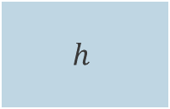
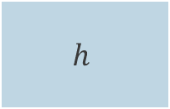

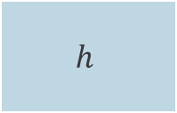
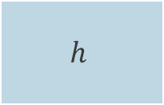
$$h$$
cat
$$h$$
$$h$$
$$h$$
« A grumpy cat held in hands »
« A grumpy cat held in hands »
$$h$$

Slide 2
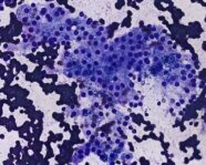
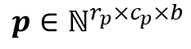
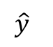
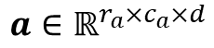
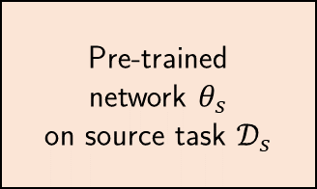
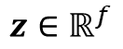
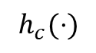
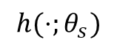
$$h(⋅;θ_{s})$$
$$h_{c}(⋅)$$
Pre-trained
network $θ_{s}$
on source task $𝒟_{s}$
Dimens. reduction
Classifier
resized centered
maximum
square crop
$$a∈ℝ^{r_{a}×c_{a}×d}$$
$$z∈ℝ^{f}$$
$$p∈ℕ^{r_{p}×c_{p}×b}$$
$$\hat{y}$$
Features extraction
Classification

Slide 3
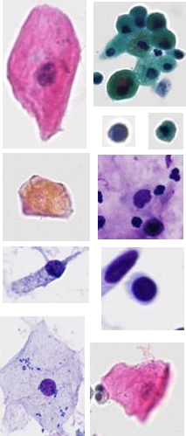
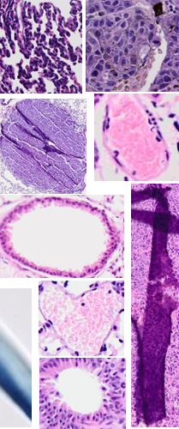
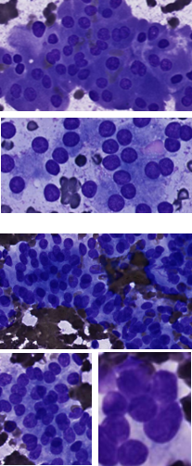
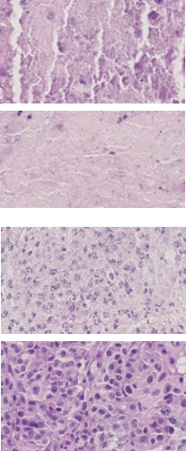
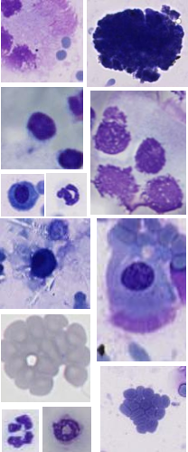
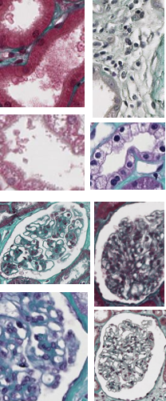
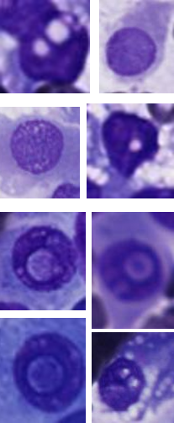
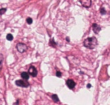
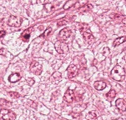
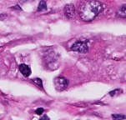
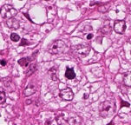
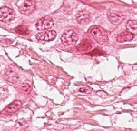
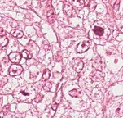
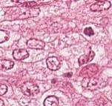
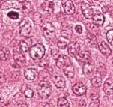
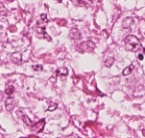
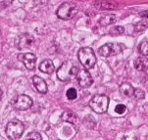
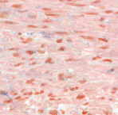
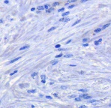
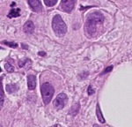
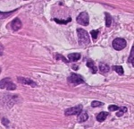

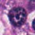
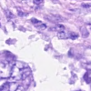
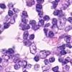
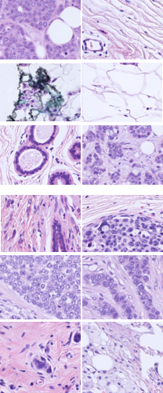
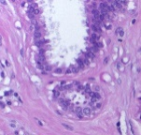
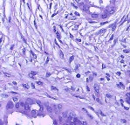
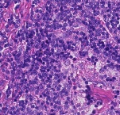
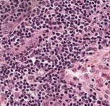
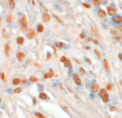
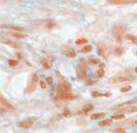
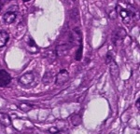
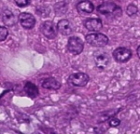
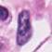

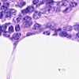
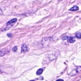
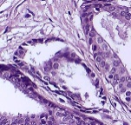
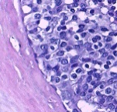






























































































Slide 4






















$$x=\left(\begin{matrix}x_{1}^{(1)} \\ x_{2}^{(1)} \\ \begin{aligned}x_{3}^{(2)} \\ x_{4}^{(4)} \\ ⋮ \\ x_{B−1}^{(T−1)} \\ x_{B}^{(T)}\end{aligned}\end{matrix}\right)$$
$$θ_{s}$$
$$z=\left(\begin{matrix}z_{1}^{(1)} \\ z_{2}^{(1)} \\ \begin{aligned}z_{3}^{(2)} \\ z_{4}^{(4)} \\ ⋮ \\ z_{B−1}^{(T−1)} \\ z_{B}^{(T)}\end{aligned}\end{matrix}\right)$$
$$θ_{1}$$
S
$$y^{(1)}$$
per-task loss
$$ℓ^{(1)}$$
$$Σ$$
$\frac{1}{B}$
$$θ_{2}$$
S
$$y^{(2)}$$
$$ℓ^{(2)}$$
$$θ_{3}$$
S
$$∅$$
$$⋮$$
$$ℒ$$
$$⋮$$
$$θ_{T−1}$$
S
$$y^{(T−1)}$$
$$ℓ^{(T−1)}$$
$$θ_{T}$$
S
$$y^{(T)}$$
$$ℓ^{(T)}$$

Slide 5



$$E=noise\left(x\right)+bias^{2}\left(x\right)+variance\left(x\right)$$
$$variance(x)$$
$$bias^{2}(x)$$
$$noise(x)$$
Trade-off
Complexity/capacity

Slide 6









Target task
Option 1: feature extraction
$$θ_{s}$$
C
$$x_{t}$$
Malignant Benign Benign
…
$$z_{t}∈ ℝ^{f}$$
$$y_{s}$$
Classify feature vector with a third-party classifier
(e.g. linear SVM)
$$θ_{s}$$
$$θ_{o}$$
Tree
Cat
Dogs
…
$$x_{s}$$
$$y_{s}$$
Use frozen network (no re-training) as feature extractor.

Slide 7
$$θ_{s}$$
$$θ_{o}$$
$$θ_{s}$$
$$θ_{n}$$
$$x_{o}$$
$$y_{o}$$
$$x_{n}$$
$$y_{n}$$
$$θ_{s}$$
$$θ_{o}$$
$$y_{o}$$
$$θ_{f}$$
$$θ_{t}$$
$$θ_{n}$$
$$x_{o}/x_{n}$$
$$θ_{n}$$
$$x_{o}$$
$$y_{o}$$
$$y_{n}$$
$$θ_{s}$$

Slide 8




















Pre-training
$$x_{s}$$
Transfer – feature extraction
$$x_{t}$$
$$y_{s}$$
$$θ_{s}$$
$$clf$$
$$y_{t}$$
$$θ_{s}$$
$${ θ}_{o}$$
Tree
Cat
Dogs
…
$$z_{t}∈ ℝ^{f}$$
Malignant Benign Benign
…
Pre-training
Transfer – fine-tuning
$$x_{s}$$
$$x_{t}$$
$$y_{s}$$
$$y_{t}$$
$$θ_{s}$$
$${ θ}_{o}$$
$$θ_{s}$$
$${ θ}_{n}$$
Malignant Benign Benign
…
Tree
Cat
Dogs
…

Slide 9


0
0
0
0
0
0
0
0
Kernel
1
2
3
0
5
6
8
1
9
2
0
2
3
5
0
7
4
6
2
3
7
0
$$σ\left(\begin{matrix} & \\ \begin{aligned} \\ \\ \\ \\ \\ \\ \end{aligned} & \end{matrix}\right)$$
0
1
0
52
47
42
0
2
1
3
8
7
5
0
41
80
91
0
4
0
7
5
0
9
0
Convolution
67
75
54
0
5
8
9
0
3
1
0
0
4
8
3
5
8
1
0
0
0
0
0
0
0
0
0
Stride ($s=2$)
Zero-padding

Slide 10























$$θ_{1}^{\left(2\right)}$$
$$σ$$
$$θ_{1}^{\left(1\right)}$$
$$σ$$
$$θ_{2}^{\left(2\right)}$$
$$σ$$
$$x_{1}$$
$$θ_{2}^{\left(1\right)}$$
$$σ$$
$$θ_{1}^{\left(3\right)}$$
$$σ′$$
$$y$$
$$x_{2}$$
$$θ_{3}^{\left(2\right)}$$
$$σ$$
$$h^{(3)}\left(⋅;θ^{\left(3\right)}\right)$$
$$x$$
$$θ_{3}^{\left(1\right)}$$
$$σ$$
$$h^{(1)}\left(⋅;θ^{\left(1\right)}\right)$$
$$θ_{4}^{\left(2\right)}$$
$$σ$$
$$h^{(2)}\left(⋅;θ^{\left(2\right)}\right)$$

Slide 11





Specimen
Small
Large
(biopsy)
(organ)
Fixation
Cut
Fixated sample in cassette
Dehydratation
Dehydrated sample
in cassette
Embedding
Tissue embedded in a paraffin block
Microtomy and application
Glass slide with unstained tissue
Staining
Glass slide with stained tissue and coverslip
Scanning

Slide 12










Biopsy
Fixation, dehydratation
Embedding
Microtomy
Staining
Scanning

Slide 13




Slide 14



Slide 16













INPUT: a left out task $t_{1}$, a random seed, a combination $h$of HP, and a shared network $θ_{s}$
OUTPUT: an transfer evaluation score (computed on left out task validation set)
$𝒟_{1}$
$X_{train}$
$X_{val}$
$$X_{test}$$
$𝒟_{2}$
$𝒟_{3}$
Train in multi-task using shared network $θ_{s}$ and hyperparameters $Θ.$
Produces a pre-trained model$θ_{s}^{(MT)}$
$$θ_{s}^{(MT)}$$
$𝒟_{4}$
Extract features for left-out task
$𝒟_{5}$
(2)
(1)
$𝒟_{n}$
$Z_{train}$
$Z_{val}$
Train a SVM using the left-out task generated features
Evaluate transfer using validation features
Transfer score
(3)
(4)

Slide 17











$$𝒟_{j}$$
$$𝒟_{k}$$
 |  | $$r_{1j}$$
 |  | $$⋮$$
$$r_{i1}$$ | $$⋯$$ | $$r_{ij}$$
$${\overline{r}}_{ 0}^{(k)}$$
Best hyperparameters combination for left-out task $𝒟_{k}$:
Transfer protocol with pre-trained model $θ_{s}$ (the model trained with $Θ_{k}$).
Final evaluation on the test set of $𝒟_{k}$ for comparison to other approaches.
$$Θ_{i}$$
$${\overline{r}}_{ i}^{(k)}$$
$$Θ_{k}=arg \min_{Θ_{i}}{{\overline{r}}_{ i}^{(k)}}$$
Rank matrix
(with task $D_{k}$ ignored)

Slide 18



Segment cell and aggregates
(self-trained model)
Nuclei detection
(Stardist, Schmidt et al. 2018)
Nuclei classification
(multi-task pre-trained model)

Slide 19






Our algorithm (I) / warm-up phase
$$𝒟_{s}$$
Model $θ_{0}$
Warm-up
$$𝒟_{l}$$
Supervised training (for W epochs)
Model $θ_{W}$

Slide 20









Model $θ_{0}$
Supervised warm-up on $𝒟_{l}$ (for W epochs)
Model $θ_{W}$
Self-training (epoch i $∈$ ]W, E])
$$𝒟_{s}$$
Pseudo-labeling
Sparsely-labeled
Model $θ_{i−1}$
Hard/soft label ?
$$𝒟_{l}$$
Self-training
Exhaustively-labeled
$$𝒟_{l}∪ 𝒟_{pl}$$
$𝒟_{pl}$ / pseudo-labeled
Supervised training
Model $θ_{i}$

Slide 21




Our algorithm (II) / self-training phase (b)
Model $θ_{W}$
Self-training (epoch i)
Pseudo-labeling
$$𝒟_{s}$$
Model $θ_{i−1}$
Hard/soft label ?
$$𝒟_{l}$$
$$𝒟_{pl}$$
Model $θ_{E}$

Slide 22



Our algorithm (II) / self-training phase (c)
Model $θ_{W}$
Self-training (epoch i)
Pseudo-labeling
$$𝒟_{s}$$
Model $θ_{i−1}$
Hard/soft label ?
$$𝒟_{l}$$
Self-training
$$𝒟_{pl}$$
$$𝒟_{l}∪ 𝒟_{pl}$$
Supervised training
Model $θ_{i}$
Model $θ_{E}$

Slide 23


Cancer
vs.
Not cancer
Predict
Train
Model
Integrate

